Slide 1
CINEMA TICKETS PREDICTION
Prepared by :
Mohammed Saeed Alshehri
Abdulelah Aldossari
Munira Alzahrani

Slide 2
Overview
Data Cleaning
Introduction
Modeling
EDA

Slide 3
Introduction
Cinema industry is not excluded from getting advantage of predictive modeling. Like other industry e.g., retail, banking, and restaurants, sale forecasts can help cinemas for cost reduction and better ROI. By forecasting sales, screening in different locations could be optimized as well as effective market targeting and pricing.

Slide 4

Dataset
- 142524 Observations
- 14 Features
From

Slide 5
Data Cleaning
1
2
3
4
Drop all values contain Nan values
Drop rows that contain irrational values
Change the column names to clearer names
Insert a column called`day_name`

Slide 6
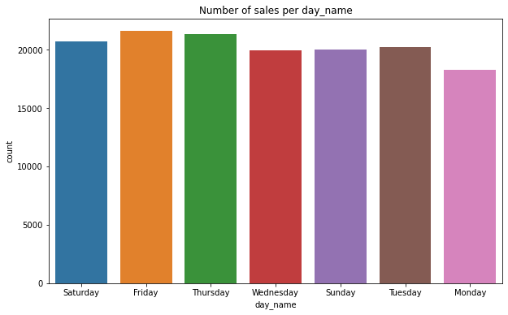
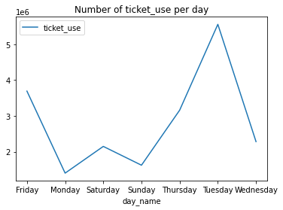
Exploratory Data Analysis (EDA)
Q1. Which `day_name` has the most number of sales?
Q2. How many `ticket_use` based on `day_name`?

Slide 7
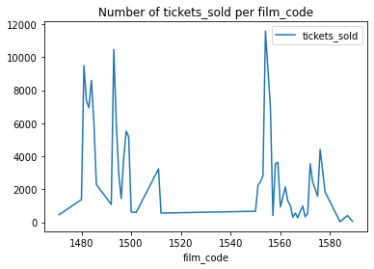
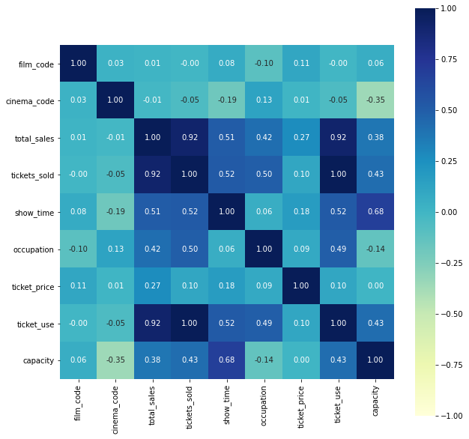
Exploratory Data Analysis (EDA)
Q3. Which `film_code` has the most `tickets_sold`?
Q4. What is the correlation between the features?

Slide 8
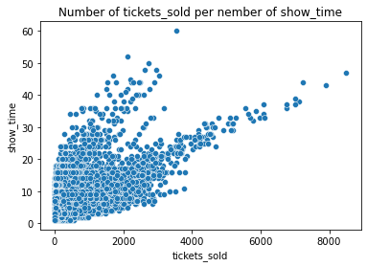
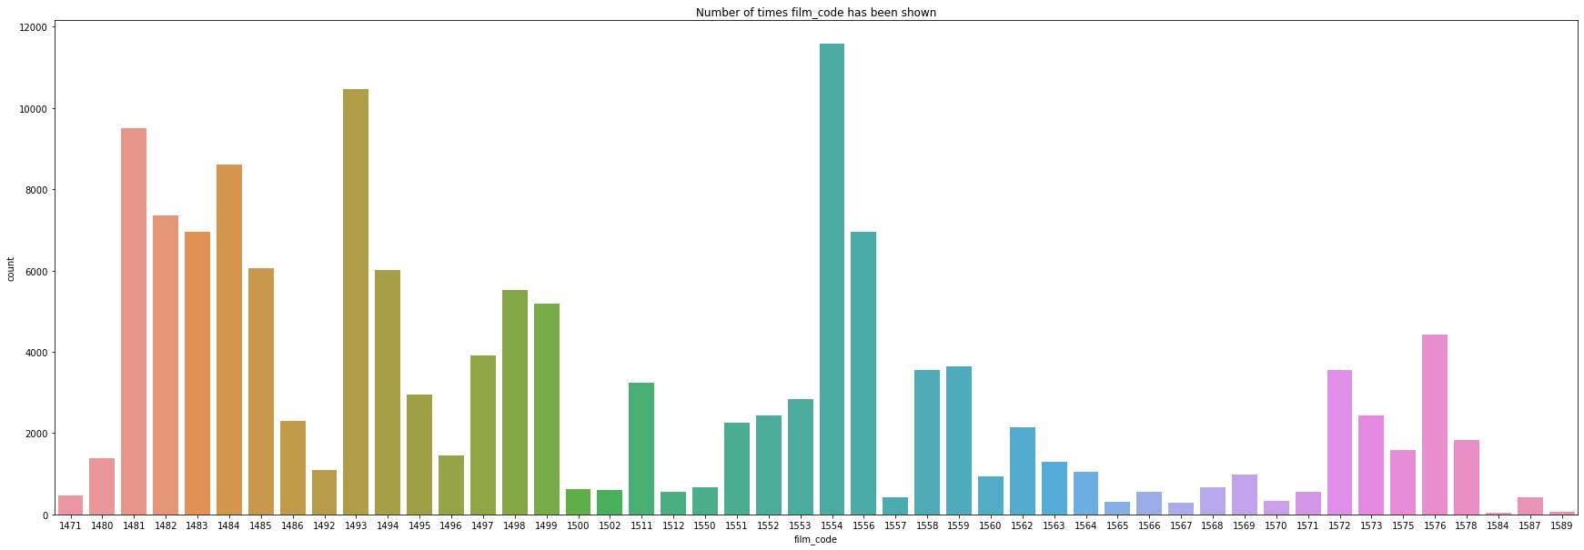
Exploratory Data Analysis (EDA)
Q5. Does `show_time` affect the `tickets_sold?
Q6. Which `film_code` is the most popular film?

Slide 9

Machine Learning Model
Regression

Slide 10
Regression Algorithms
Linear Regression
polynomial
Decision Tree
Ridge
Random Forest

Slide 11
r^2 score | Algorithms
The r^2 score value for train is 0.879
The r^2 score value for test is 0.880
Linear Regression
The r^2 score value for train is 0.879
The r^2 score value for test is 0.880
Ridge
MODELS
The r^2 score value for train is 1.000
The r^2 score value for test is 1.000
polynomial
The r^2 score value for train is 0.996
The r^2 score value for test is 0.997
Random Forest
The r^2 score value for train is 0.993
The r^2 score value for test is 0.996
Decision Tree

Slide 12
Conclusion
To sum up, to know the days when the gross income is low and trying to increase it by means of discounts for ticket and to develop it. Also, to create offer on the ticket to invest more tickets in some days that people cannot go to it

Slide 13

Tools
NumPy
Seaborn
Pandas
Matplotlib
Datetime
Scikit-learn

Slide 14
Any Questions ?

